Slide 1
EMPLOYEE MANAGEMENT SYSTEM
Presented by,
Indira Saravanan

Slide 2
Synopsis
Aim
Abstract
System Requirement
CURD Operation
Spring Boot
DevTool
Mysql Database
JPA Repository
Annotations in STS
Application.properties
Dependencies
Project
(i)Backend
(ii)Frontend

Slide 3
Aim
The main aim of this project is mainly for handle the database of the employees.
Abstract
Employee management system is an application based system, having two applications developed, one for employers to manage employee details and another for employees to mark their attendance.
Every organisation whether government or private uses an information system to store data of their staff.

Slide 4
Software Requirement
WEB SERVER SYSTEM
System Used | Remarks
Tomcat | It is used as application server as well as web server
Angular | It is being used as frontend of the system and even for testing.
DATABASE SERVER SYSTEM
Software Used | Remark
MySQL | It is being used as back-end which holds all the database
CLIENT SERVER
Software Used | Remark
Angular | It is being used as frontend of the system and even for testing.

Slide 5
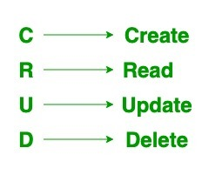
CURD
CRUD is data-oriented and the standardized use of HTTP methods.
standard CRUD Operations is as follows:
POST: Creates a new resource
GET: Reads/Retrieve a resource
PUT: Updates an existing resource
DELETE: Deletes a resource

Slide 6
Spring Boot
* Spring Boot is built on the top of the spring and contains all the features of spring.
* Spring Boot is a microservice-based framework and making a production-ready application in it takes very little time.
Dev Tool
* Developer are programs that allow a developer to create, test and debug software.
* Current browsers provide integrated developer tools, which allow to inspect a website.
* The spring boot devtool module includes an embedded Live Reload server that can be used to trigger a browser refresh when a resource is changed.
Mysql Database
MySQL is an RDBMS (Relational Database Management System) based on the SQL (Structured Query Language),which is the popular language for accessing and managing the records in the database.
The data in a MySQL database are stored in tables.

Slide 7
A table is a collection of related data, and it consists of columns and rows.
Some of the features of MySQL are listed below:
It is a database system used on the web
It runs on a server
It is ideal for both small and large applications
It is very fast, reliable, and easy to use
It uses standard SQL
JPA Repository
JPA Repository is a JPA (Java Persistence API) specific extension of Repository.
It contains the full API of Crud Repository and Paging And Sorting Repository.
So it contains API for basic CRUD operations and also API for pagination and sorting.

Slide 8
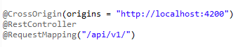
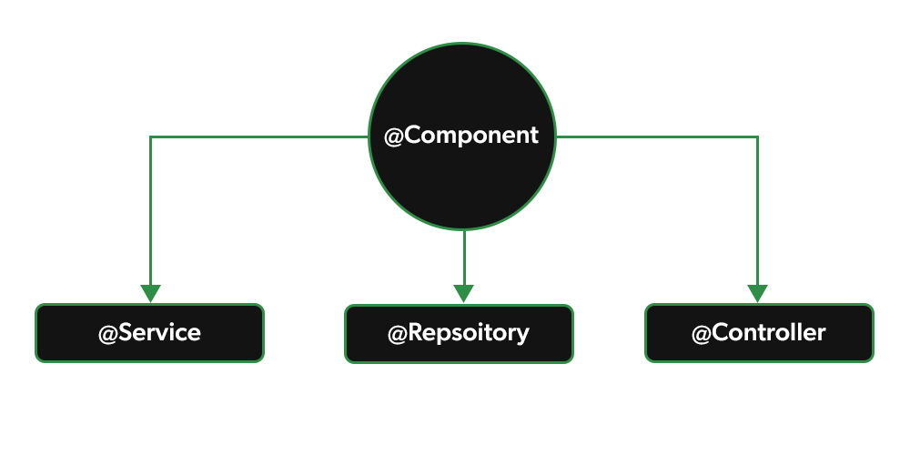
Annotations In STS
@Cross-Origin Resource Sharing (CORS)
It is an HTTP-header based mechanism that allows a server to indicate any origins (domain, scheme, or port) other than its own from which a browser should permit loading resources.

Slide 9
@Service Annotation
→In an application, the business logic resides within the service layer so we use the @Service Annotation to indicate that a class belongs to that layer.
→It is a specialization of @Component Annotation.
@Repository Annotation
@Repository Annotation is also a specialization of @Component annotation which is used to indicate that the class provides the mechanism for storage, retrieval, update, delete and search operation on objects.
@Controller Annotation
→Spring @Controller annotation is also a specialization of @Component annotation.
→The @Controller annotation indicates that a particular class serves the role of a controller.
→Spring Controller annotation is typically used in combination with annotated handler methods based on the @RequestMapping annotation.
@RequestMapping
→ Request Mapping annotation is used to map web requests onto specific handler classes and/or handler method
→It can be applied to the controller class as well as methods.

Slide 10
Angular
Angular is a single-page application web framework developed by Google to create an application for web, mobile, and desktop.
Node Js
Nodejs is a run time environment that allows us to load JavaScript applications into the server directly.
Authorization Service
Authorization is the process of giving permission to the user to access certain resource in the system.
Only the authenticated user can be authorised to access a resource.

Slide 11
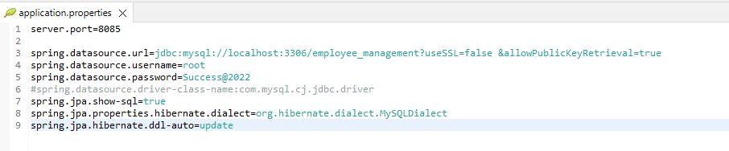
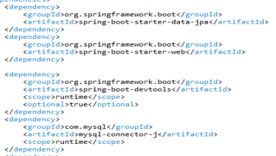
Application .properties:
Dependencies:

Slide 12
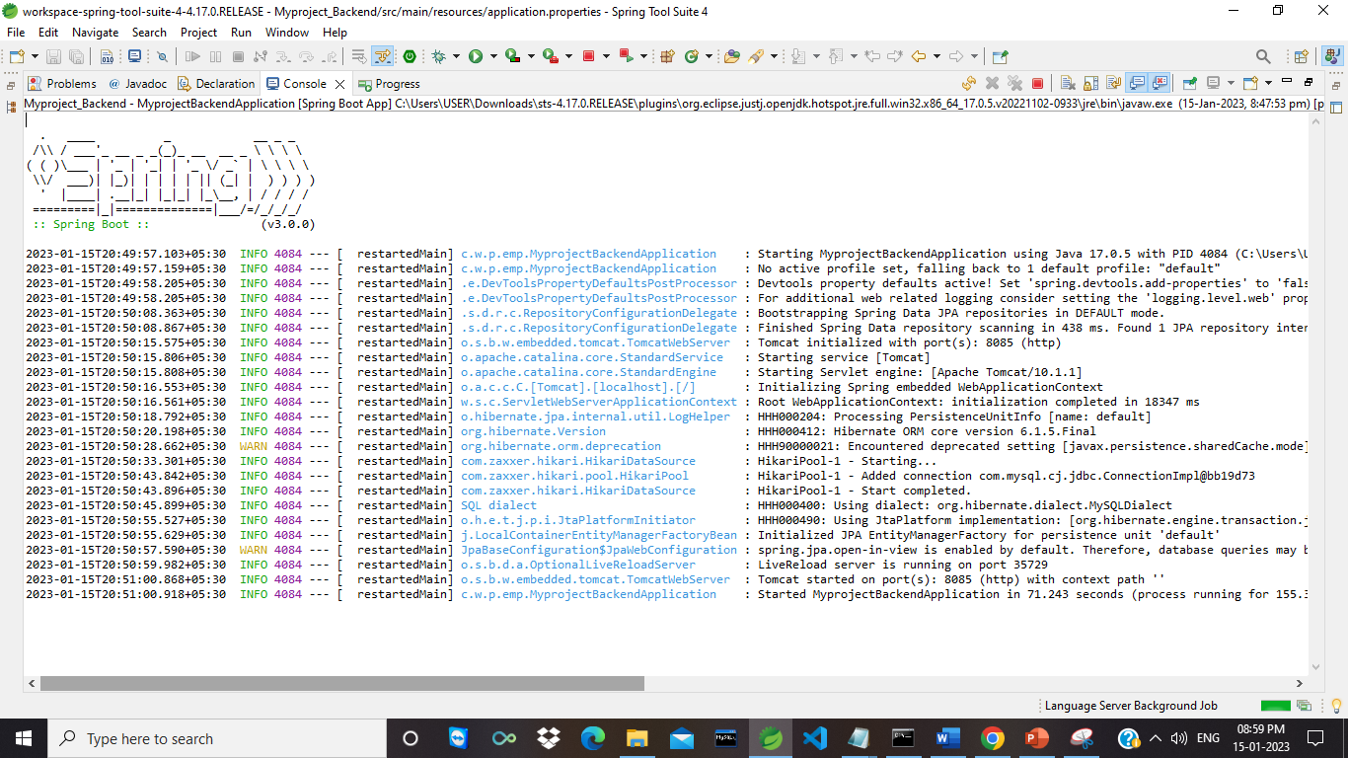
Backend Running Status

Slide 13
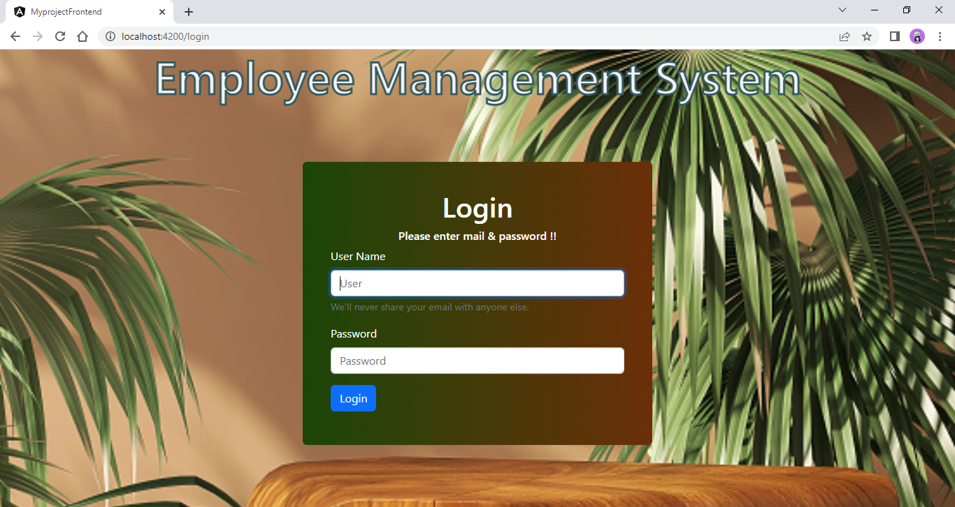
Login Page

Slide 14
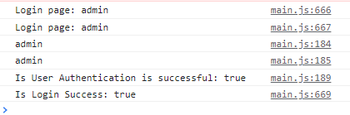
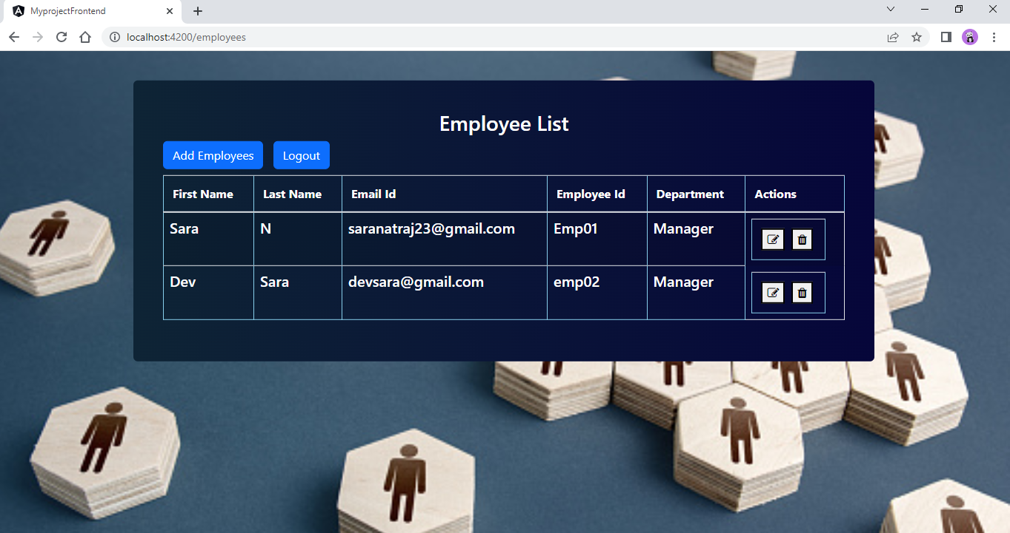
→ After click login button then the developer tool like this and it redirect to employee list
page
Employee List Page

Slide 15
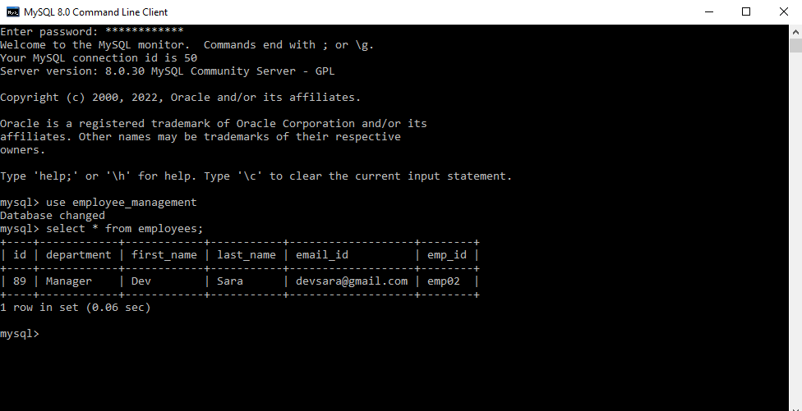
Mysql Database with some records

Slide 16
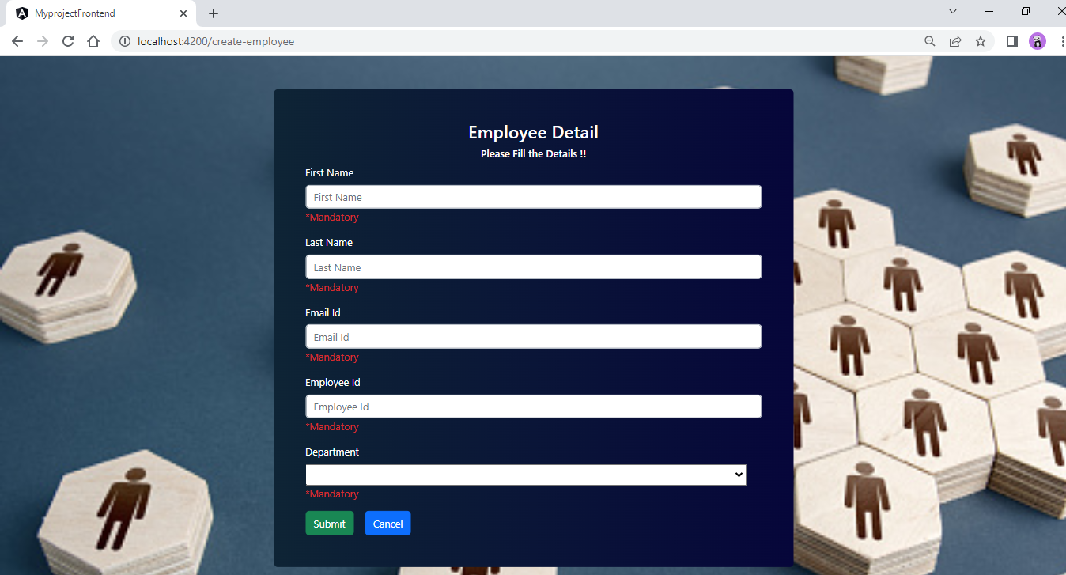
Adding Employees

Slide 17
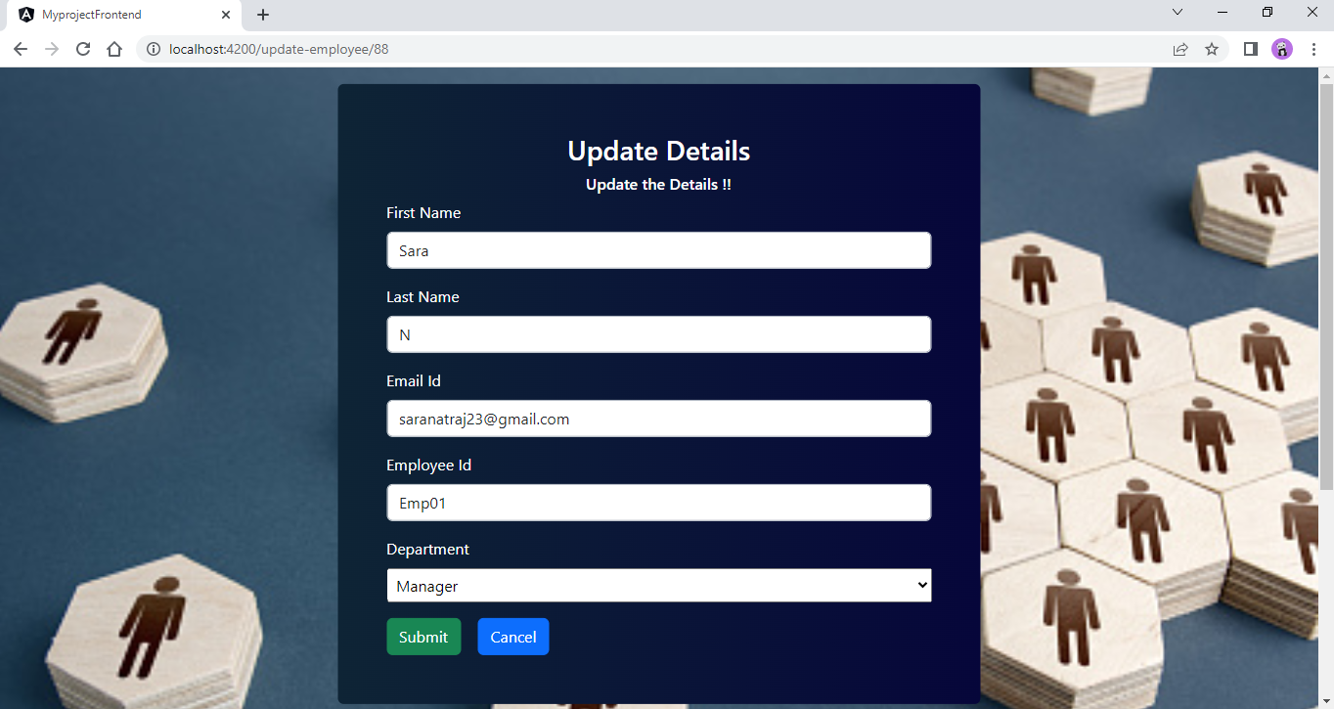
Update Details

Slide 18
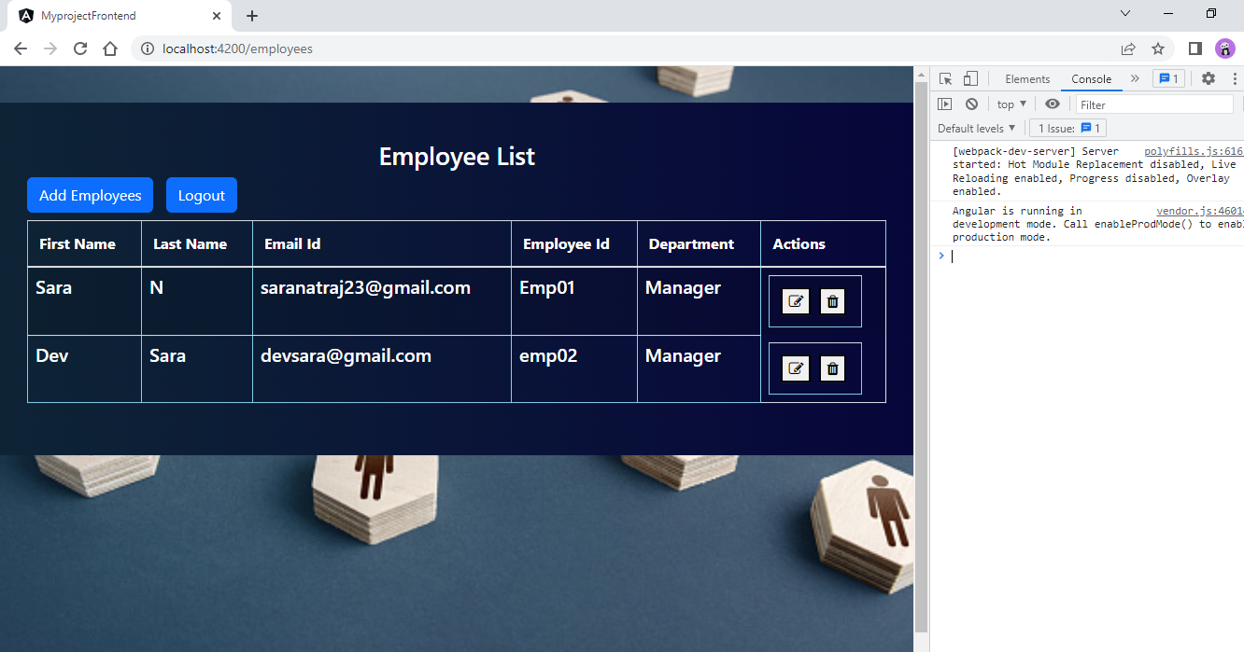
→ Employee List before delete

Slide 19
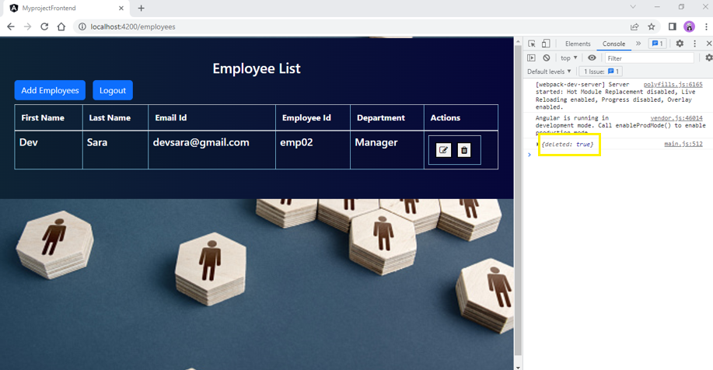
After delete the employee details then in the developer tools shows
the message.

Slide 20
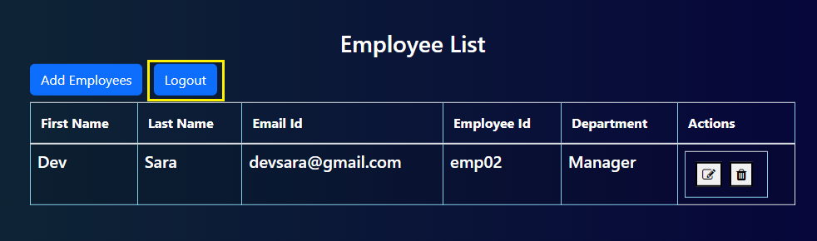
After clicking the logout button it automatically redirect to login page

Slide 21
THANK YOU

